Slide 1

EXPLORATORY DATA ANALYSIS IPL SEASONS(2008-2017)
PERFORMANCE REVIEW : MUMBAI INDIANS
ANIKET NG

Slide 2
MI AT HOME
FORTRESS FOR MI :
Mumbai Indians have a great winning record at Mumbai with a winning percentage of 66%.
Out of 68 Matches played at Wankhede Stadium, Brabourne Stadium and D Y Patil Sport Complex, Mumbai Indians have managed to win 45 matches.

Slide 3
MI AT HOME : WINNING THE TOSS
MI AFTER WINNING THE TOSS AT MUMBAI:
Mumbai Indians have won 54% of the matches at Mumbai when they have elected to bat first.
Mumbai Indians have won 46% of the matches at Mumbai when they have elected to field first.
MATCHES WHEN MI WON THE TOSS: 26
MATCHES WHEN MI WON:
BATTING FIRST: 14
FIELDING FIRST: 12

Slide 4
MI AWAY FROM HOME
MI AWAY FROM HOME:
Mumbai Indians have a winning record of 53% away from home.
Out of 89 Matches played all across the country and in South Africa, Mumbai Indians have managed to win 47 matches.

Slide 5
Mi against all OTHER teams
Mumbai Indians have a total win percentage of 58.59% in all the seasons of the Indian Premier League between 2008 to 2017.
From the above analysis, MI have struggled against teams like Rising Pune Super giants and Kochi Tuskers.

Slide 6
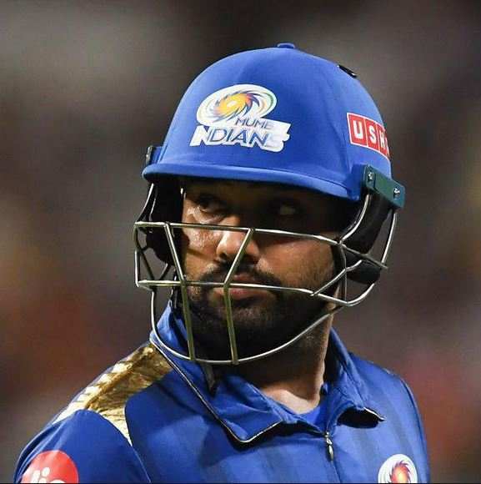
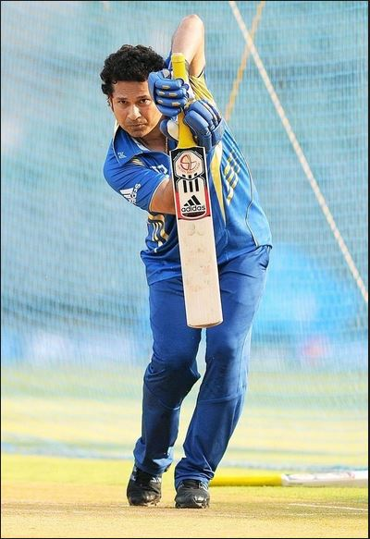
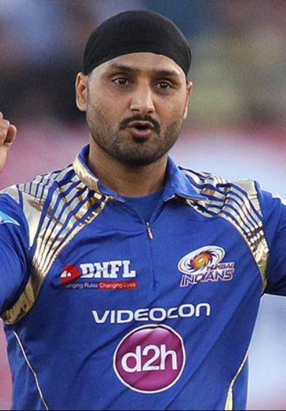
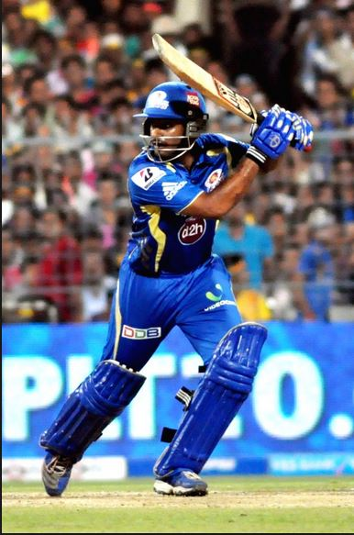
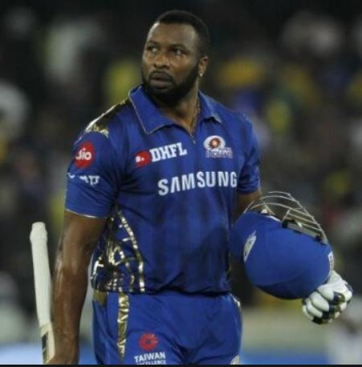
MI’S MAN OF THE MATCH :
R.SHARMA A.RAYUDU S.TENDULKAR K.POLLARD HARBHAJAN
NO. OF TIMES MAN OF THE MATCH FOR MI(2008-2017)
11 9 8 7 6

Slide 7
PLAYER ANALYSIS : ROHIT SHARMA

Slide 8
STATISTICS : IPL(2011-2017)
ROHIT SHARMA FOR MI:
Made his debut for MI in the 2011 season.
MATCHES | 109
TOTAL RUNS | 3037
AVERAGE | 27.86
STRIKE RATE | 131.64

Slide 9
STATISTICS : IPL(2011-2017)
MILESTONE | NO. OF TIMES | REMARK
100’S | 1 | 109* VS KKR
50’S | 23 | --
30’S | 13 | --
Rohit Sharma scored his first ever century against Kolkata Knight Riders,
scoring 109* off 87 balls in 2011.

Slide 10
RUNS ANALYSIS : ROHIT SHARMA
RUNS | NO. OF TIMES | RUNS SCORED
1’S | 1011 | 1011
2’S | 121 | 242
3’S | 4 | 12
4’S | 258 | 1032
5’S | 1 | 5
6’S | 121 | 726
ROHIT SHARMA’S RUNS ANALYSIS

Slide 11
Rohit sharma’s wicket-takers in Ipl(2011-2017)
BOWLER | TEAM | NO. OF TIMES
S NARINE | KKR | 5
D KULKARNI | RR,GL | 4
DJ BRAVO | CSK,GL | 4
A MISHRA | DC,DD | 4
J FAULKNER | RR,GL | 3
Sunil Narine has got Rohit Sharma out 5 times during IPL (2011-2017)

Slide 12
Rohit sharma against different bowlers in ipl(2011-2017):
BOWLER | TEAM | RUNS SCORED
M MORKEL | DD,KKR | 99
U YADAV | DD,KKR | 88
S NARINE | KKR | 87
P CHAWLA | KXIP,KKR | 86
S AL HASAN | KKR | 82
From the table above, Rohit Sharma has scored most of his runs against the bowlers who have being or are a part of Kolkata Knight Riders.

Slide 13
Rohit sharma’s dismissal analysis :
KINDS | NO. OF TIMES
CAUGHT | 55
BOWLED | 15
STUMPED | 2
RUN OUT | 6
LBW | 7
CAUGHT AND BOWLED | 5
THE ABOVE PIE CHART DISPLAYS THE KIND’S OF DISMISSAL FOR ROHIT SHARMA IN IPL SEASON(2011-2017)

Slide 14
Rohit sharma vs ipl teams(2011-2017)
TOTAL NUMBER OF RUNS MADE BY ROHIT AGAINST ALL OTHER IPL TEAMS IN SEASONS(2011-2017)

Slide 15
Thank you for viewing the analysis. hope you liked it.
MICRO-PROJECT BY :
ANIKET.N.GAIKWAD
DATA SCIENCE ENTHUSIAST
PUNE

